Slide 1
Sage 100: Using Business Object Interface - Beginner
Part 1 of 2 – Course Number P-ERP22 and P-ERP22B

Slide 2
CPE Credit
In order to receive CPE credit for this session, you must be present for the entire session.
Session Code: P-ERP22B (Monday) OR P-ERP22 (Tuesday)
Recommended CPE Credit = 1
Delivery Method = Group Live
Field of Study = Specialized Knowledge and Applications
Visit the Sage SummitConnect kiosks to enter CPE credit during the conference.

Slide 3
Introduction
Steve Malmgren – Sr. Director of Development
Elliott Pritchard – Principal Software Architect
This presentation will be available online after the conference. You will receive an email for the Summit session website approximately 1-2 weeks after Summit. (Or sooner if you brought your laptop or a jump drive)
Follow us on Twitter: @Sage_Summit, @swmalm
Use the official Summit hashtag: #SageSummit

Slide 4
Multipart Sessions
This session is part of a focused, multipart session series.
Attendees that register for a multipart session series must register for all parts in the series.

Slide 5
Learning Objectives
After participating in this session, you will be able to:
Understand the different Object Types available for use in Sage 100
Distinguish between “using” objects and “changing the behavior” of objects
Use the key methods and properties of each object type

Slide 6
Key Concepts and Terms
UDS – User Defined Scripts. Scripts that can be attached to buttons, or database events.
UI – User Interface. This refers to Sage 100 entry screens
API – Application Programming Interface.
Business Object Interface – API to programmatically “use” Sage 100 objects to read and write data, generate and print reports, invoke register/update routines.
Business Rules – validations that are enforced to ensure proper data is written to a table.
COM – Component Object Model – using properties and methods of objects

Slide 7
Sage 100 Object Types
Type | Suffix | Description
Service | _SVC | Read only access to tables
Business | _BUS | Read/Write/Delete enforces business rules when writing to tables
Reports and Forms | _RPT | Print reports and forms with no UI
Update | _UPD | Audit trail and update processes
User Interface | _UI | Sage 100 screens

Slide 8
Approach
Overview of object type and how they are used
Cover Key Methods and Properties of each object type
Examine code in example scripts
Run sample scripts with debug trace window visible
A lot to cover, all examples and presentation will be available to review during conference and/or when you get back to your office

Slide 9
Naming Conventions
Service and Business
Table name + _SVC or _BUS
e.g. AR_Customer_SVC; AP_Vendor_BUS
Exception - Line entry business objects (_BUS):
Table names follow convention of XX_XxxxxXxxxHeader and XX_XxxxxXxxxDetail
Object name disregards Header and Detail naming is the object is responsible for both tables
Name: SO_SalesOrder_BUS; AR_CashReceipts_BUS
Reports, Forms, Updates and UI, consult Object Reference (see next slide) to be sure

Slide 10
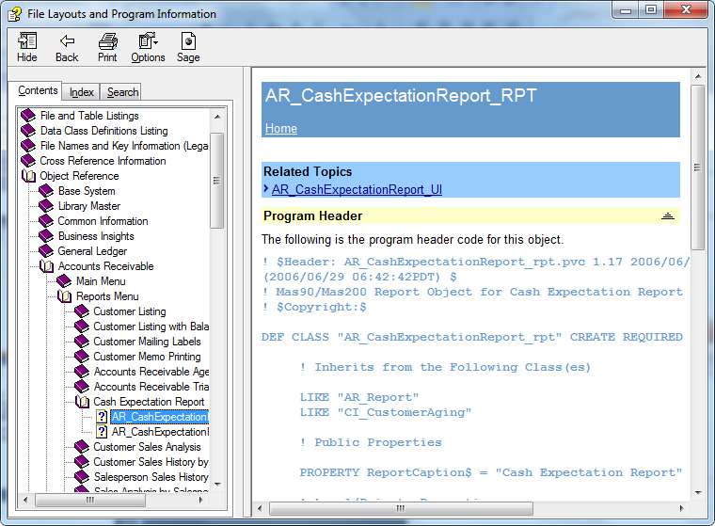

Slide 11
Service Objects (_SVC) - Summary
Service Objects are Read Only access to tables in the system.
Primarily used by the Business Objects (_BUS) to validate fields against other tables.
Sales Order validates the customer being added to the SO_SalesOrderHeader table using the AR_Customer_SVC object
Supports flow of UDFs
Some Service Objects provide other services such as:
calculating an aging for a customer
calculating an invoice due date based on a terms code
SO Sales Order, SO Invoice and AR Invoice all use the AR_TermsCode_SVC.CalcDates() method to calculate due date and discount dates
View Public Methods in Object Reference for desired object and inherited classes

Slide 12
Service Objects (_SVC) - Summary
TIP – When obtaining an object handle to a Service Object, use oBusObj.GetChildHandle(<dataSource> As String) rather than oSession.GetObject(<serviceObject As String) to minimize memory usage.
First Option – service object is already in memory. May need to do a oSvc.ReadAdditional(<dataSource As String) OR .Find() to populate data
Second Option – creates a new copy of the object in memory

Slide 13
Service Objects (Key Methods() and Properties)
MoveFirst(); MoveNext(); MoveLast(); MovePrevious()
GetKeyColumns() As String – Helper Method
GetColumns() As String – Helper Method
SetKeyValue(<keyColumn As String>, <keyValue As String)
Find() - no arguments, must use SetKeyValue() for each key column Find(<keyValue as String>) - only used on single column keys

Slide 14
Service Objects (Key Methods() and Properties)
GetValue(<column As String>, <val As String OR Numeric)
GetRecord(<rec As String>, <pvx IOL - not useful in scripting instead use GetColumns()>)
SetBrowseFilter(<first n characters to filter As String>)
BOF; EOF – indicates whether or not the row pointer is at the beginning or end of file respectively
LastErrorNum, LastErrorMsg As String – contains error code and message of last error that occurred. TIP - May not be based on the last operation if successful. (NOTE: These properties are in ALL object types and should be checked on failed method calls)

Slide 15
Let’s Take a Look – Service Object (AR_Customer_svc)
Appendix – To have a look at some background info
Service_AR_Customer_svc.txt – Service Object Script

Slide 16
Business Objects (_BUS) - Summary
Business Objects enforce all of the business rules for adding data into the system.
Behavior can be changed via User-Defined Scripting!!
Always use Business Objects rather than writing directly to the database to ensure the integrity of the system
VI uses the Business Objects to import data as does the User Interface (UI) of Sage 100
Some history tables have business objects defined, BUT are for migrating a customer from another system to Sage 100. Best practice is to use data entry tables and process through the updates (which can all be automated) to get data into history tables.

Slide 17
Business Objects - Key Methods() and Properties
Inherits all Service Object methods and properties
SetKey() - Same as Find (with or without arguments, but used to place a row into an EditState for new rows)
SetValue(<column As String>, <val As String or Numeric>)
Write() - saves changes
Delete() - deletes current row
Clear() - takes row out of edit state and discards any changes

Slide 18
Business Objects - Key Methods() and Properties
GetDataSources() As String - returns list of columns that validate against a Service object
GetChildHandle(<data source As String>) As Object - returns an Object handle to a Service Object
ReadAdditonal() - reads ALL child data sources for current row ReadAdditional(<data source As String>) - read specified data source
SetCopyKeyValue(<keyColumn As String>, <keyValue As String>)
CopyFrom()

Slide 19
Business Objects - Key Methods() and Properties
EditState – 0 if no record in memory; 1 if existing record; 2 if new record
RecordChanged – 0 if no changes, 1 if record has changed

Slide 20
Let’s Take a Look – Business Object (AR_Customer_bus)
Business_AR_Customer_bus.txt – Business Object Script – Existing Customer
NewRecord_AR_Customer_bus.txt – Business Object – Create New Customer (GetNextCustomerNo(); CopyFrom())

Slide 21
Summary - Service and Business Objects
Service Objects – Read Only
SetKeyValue()
Find()
GetValue()
Business Objects – Read/Write/Delete
SetKeyValue()
SetKey()
GetValue()
SetValue()
Write()
Delete()

Slide 22
Summary - Service and Business Objects
Service Objects – What we’ve done
Browsed rows with and without a browse filter
Examined BOF and EOF
Found a specific row and retrieved a value
Used a While/Wend loop to calculate over 90 day balance for division 01
Business Objects – What we’ve done
Edited an existing record; examined a failed SetValue() and Delete() method call
Created a new customer; used GetNextCustomerNo; used SetCopyKeyValue() and CopyFrom() methods
Saw how to use GetChildHandle() to get a service object handle

Slide 23
Business Objects (Line Entry) - Key Methods and Properties
AddLine() - creates a new, empty line with default values
Lines – object handle to the detail business object
Set oLines = oBusObj.AsObject(oBusObj.Lines)
Just like any other business object (GetValue(); SetValue(); Write(); Delete() )
GetEditKey(<lineKey As String>) – Used to get the edit key of a line based on the 6 character LineKey column (will cover these in Part 2)
EditLine(<editKey As String>)
DeleteLine(<editKey As String>)

Slide 24
Let’s Take a Look – Business Object (SO_SalesOrder_bus)
Create_SO_SalesOrder_bus.txt – Business Object Script – Create SalesOrder

Slide 25
Summary – Line Entry Business Objects
What we’ve done
Used a SO object from the AR module – Set the Module and Date to SO prior to “getting” the SO_SalesOrder_bus object
GetNextSalesOrderNo
SET oLines to the oSO.AsObject(oSO.Lines) property to access the detail business object
Used the oScript.DebugPrint() to display any error messages
Used the oScript.SetStorageVar() to store off a Sales Order number as well as detail line to be used in the edit line and delete line scripts for Part 2.

Slide 26
Report Objects (_RPT) - Summary
Report Objects are used to print, preview, defer or deliver (using paperless office) any Report or Form via the Business Object Interface.
Forms need to be run once from the UI so that the customer can choose which report template (Marbled, Plain Paper, etc.) to use.
NOTE: Audit Journals and Registers, as well as related recaps and error logs are printed from within the Update (_UPD) objects

Slide 27
Report Objects - Key Methods() and Properties
SelectReportSetting(<savedReportSetting As String)
If no saved settings available can ALWAYS use “STANDARD” which is factory defaults
Use SY_ReportSetting_svc to determine any saved settings
ProcessReport(<destination As String)
“PREVIEW”
“DEFERRED”
“PRINT” – based on default printer for report setting
“EXPORT”, “EXPORTDATA” (warning prompts user for type and location)

Slide 28
FORM Objects - Key Methods() and Properties
QuickPrint As String
Not all forms support this – Check Object Reference (e.g. AR_Statement_rpt does not, SO_SalesOrderPrinting_rpt does)
TIP: Must select a template (e.g. marbled, plain paper, etc.) first via the UI or script will not work

Slide 29
Let’s Take a Look – Report and Form Objects
ReportSimple_AR_AgedInvoice_rpt.txt – Report Object Script
QuickPrint_SO_SalesOrderPrinting_rpt.txt – Forms Object

Slide 30
Summary – Report and Form Objects
What we’ve done
Used SelectReportSetting() for both STANDARD and saved setting (even had to set one up since it failed the first time)
Used ProcessReport() for all output types
Used oScript.GetStorageVar() to retrieve the sales order number created and saved off in another script, to use to set the QuickPrint property of a FORM object

Slide 31
Update Objects (_UPD) - Summary
Update Objects are used to post data entry transaction through to the history tables and to post GL transaction associated with those entries.
Encompasses both the Register (audit trail report) and the update posting logic.
The Register must be “Printed” either to hard copy, paperless office or deferred print in order for the transactions to be updated. (Previewed registers can only be updated with appropriate security event rights)
If errors are detected during the register printing, the update cannot continue and an error log can be printed

Slide 32
Update Objects - Key Methods() and Properties
ProcessReport(<destination As String)
“PREVIEW” – cannot update unless Security Event rights
“DEFERRED”
“PRINT” – based on default printer for report setting
“EXPORT”, “EXPORTDATA” (warning prompts user for type and location)
Update() – Executes the update process

Slide 33
Let’s Take a Look – Update Objects
InvoiceOrder_SO_Invoice_bus.txt – Invoice Order Script (Bonus Coverage!!)
Update_SO_SalesJournal_upd.txt – Update Object

Slide 34
Summary – Update Objects
What we’ve done
Covered how to invoice a sales order and copy detail lines from the sales order to the invoice (Bonus coverage)
Used the ProcessReport() to print the main Audit Trail Register. Same method as in the reports, so all output types are available
NOTE: PREVIEW will not allow update unless have proper security event rights
ProcessReport() can fail if there is an error condition.
Used the Update() method to post the Invoices through to GL, Open Invoice, History, etc.

Slide 35
User Interface Objects (_UI) - Summary
User Interface objects are used to display the Sage 100 data entry screens
The object class names are used to obtain security rights at a task level.
As an alternative, can be launched in a separate process using the oSession.InvokeTask() method

Slide 36
UI Objects - Key Methods() and Properties
Process() – displays UI
Process(<recordToDisplay As String)
Will bring the record (e.g. oARCust.Process(“01ABF”) – will display customer 01-ABF

Slide 37
Let’s Take a Look – UI Objects
UI_AR_Customer_ui.txt – AR_Customer_UI

Slide 38
Questions?

Slide 39
Additional Learning Opportunities
For information about additional learning opportunities visit www.sageu.com (Sage University).
Training options include:
Anytime Learning—Recorded online training sessions.
Realtime Learning—Live, online learning.
Replay Learning—Recordings of live classes.

Slide 40
Your Feedback is Important to Us!
Please visit a Sage SummitSurvey kiosks to complete the evaluation form for this session.
Remember each completed survey form is another entry for one of three iPad drawings.
Your feedback helps us improve future sessions and presentation techniques.
Please include your session code on the evaluation form:
Monday (P-ERP22B)
Tuesday (P-ERP22)

Slide 41
Contact Us
Presenter Contact Information:
Steve Malmgren, Elliott Pritchard
Twitter @swmalm
Follow us on Twitter: @Sage_Summit,
Use the official Summit hashtag: #SageSummit
Thank you for your participation.

Slide 42
Appendix
How to Enable oScript.DebugPrint()
Creating Objects
Scripting.doc
Script Events
Link to 4.40 Customizer Recorded Sessions
Link to 4.30 Customizer Recorded Sessions
Microsoft's On-line VBScript Reference
Back

Slide 43
How to Enable oScript.DebugPrint()

Slide 44
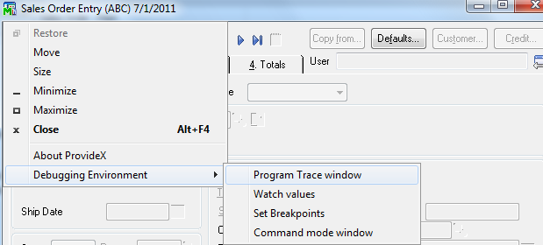
Right-Click on title bar – Select Debugging Environment..Program Trace window

Slide 45
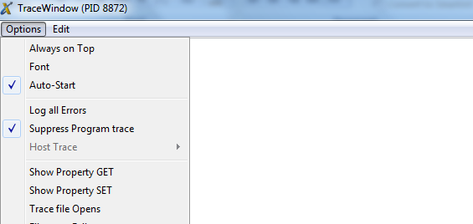
Displays this window – Select Suppress Program Trace and optional Auto-Start during script debugging

Slide 46
Creating Objects
User-Defined Scripting (4.40 and above)
oCustSvc = oSession.GetObject(“AR_Customer_svc”) If oCustSvc <> 0 then SET oCustSvc = oSession.AsObject(oCustSvc) End If
Security of current session is used to establish authorization
COM (Providex.Script)
Set oSession = oPVXScript.NewObject(“SY_Session”)
… (establish user, password for login, set module and module date; check security, etc.) …
Set oCustSvc = oPVXScript.NewObject(“AR_Customer_svc, oSession)

Slide 47
Referencing Existing Objects
User-Defined Scripting (4.40 and above)
SET oCustSvc = oBusObj.AsObject(GetChildHandle(“CustomerNo”))
SET oLines = oBusObj.AsObject(oBusObj.Lines)
NOTE: User-Defined Scripting requires the .AsObject() wrapper to indicate return type is an object handle
COM (Providex.Script)
SET oCustSvc = oBusObj.oGetChildHandle(“CustomerNo”)
SET oLines = oBusObj.oLines
NOTE: o prefix in oBusObj.oLines to indicate variable return type is an object handle

Slide 48
Script Events
Event | Type | Script Executes…
Pre-Validate | Column | After dictionary validation, prior to Sage/Master Developer
Post-Validate | Column | After the column value has been validated
Script-Initialization | Table | Runs once per business object on first script run
Set-Default-Values | Table | When a new record is established in the business object
Pre-Write | Table | Before a record is written
Post-Write | Table | After a record is written
Pre-Delete | Table | Before a record is deleted
Post-Delete | Table | After a record is deleted
Post-Read | Table | After a record is read
Pre-Totals | Table | Line Entry only, before totals are calculated

